Slide 1

Recognition Changes in Social State Resting upon Arabic Media
A Quantitative Pipeline for Monitoring Discourse Changes During the Israel-Gaza Conflict
Project Focus: Identification of Linguistic ‘Change Points’
and ‘War Phases’ via X (Twitter) Data using google Colab
Authors: Shadi Alkeesh, Ayman Haj
Supervisors: Prof. Zeev Volkovich, Dr. Renata Avros
Project Code: 26-1-R-20
Date: 26/01/2026

Slide 2
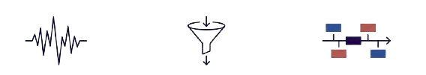
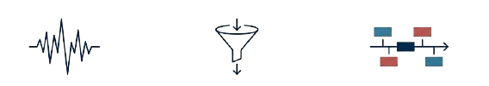
Abstract
Objective
Approach
Outcome
To bridge the gap between traditional journalism analysis and modern social media mining. The project upgrades an existing platform - originally designed for static press - to handle the chaotic, noisy nature of Arabic tweets.
Input: Real-time X (Twitter) data stream commencing 7 Oct 2023.
Core Tech: N-gram Vector Space Models (VSM) adapted for Arabic morphology.
Filtering: Normalized Median (V1) to remove sparse noise.
Smoothing: Haar Wavelet
Transforms to detect edges.
A system capable of detecting 'Social State' fluctuations and grouping chronological days into linguistically homogeneous 'War Phases'.
The system successfully identified known geopolitical turning points purely through linguistic shifts.

Slide 3



The Evolution of the 'Social Mirror'
The Static Mirror
The Dynamic Mirror
  Subject: Traditional Press (e.g., Al-Ahraam)
  Cycle: 24-hour editorial loop
  Nature: Curated, static, reflects official ideology
  Context: Used by Volkovich et al. (2016) to track the 'Arab Spring'.
  Subject: Social Networks (X/Twitter)
  Cycle: Real-time, continuous stream
  Nature: Unfiltered, chaotic, reflects immediate psyche
  Context: Analyzing the Israel-Gaza conflict (Oct 2023-Present).
Core Insight:
While newspapers reflect a curated view of history, social platforms reflect the raw 'Social State.'
However, this reflection is distorted by significant noise, requiring advanced denoising.

Slide 4

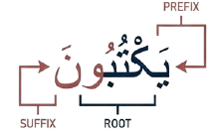
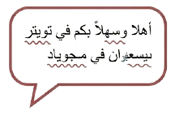
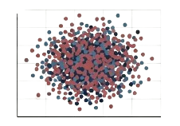
The Challenge: Arabic Morphology in the Digital Wild
Morphological Complexity
The 'Twitter' Distortion
Dimensionality Explosion
Rich system of prefixes, suffixes, and 'broken plurals.'
High usage of conjugation creates a massive number of unique word forms.
Slang, dialects, and non-standard spellings.
  Frequent omission of diacritics and inconsistent use of characters.
Infinite vocabulary size due to user-generated errors.
  'Bag of Words' models - we need a robust N-gram dynamic approach.

Slide 5
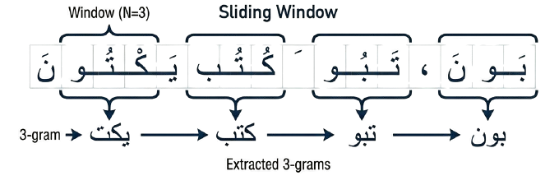




The Engine: N-Gram Vector Space Model (VSM)
Concept:
Why does this work?
A N-gram is a connecting sequence of N
characters from a text. We use (e.g., 3-grams)
  to capture the 'trilateral root' of Arabic words.
  1. Implicit Lemmatization: Captures root meaning without complex dictionaries.
  2. Error Tolerance: Whether a user writes 'the-bombing' or 'and-bombing', the root sequence remains detectable.

Slide 6



Step 1: The Normalization Pipeline
Raw Input
The NLP Filter
Standardized Output
  Alef Normalization: Convert all to simple Alef (ا).
  De-Noising: Remove diacritics & Tatweel.
  Spelling Correction: Taa Marbuta (ة) → Haa (ه).
Text with inconsistent
Alef (أ ,إ ,آ),
diacritics
(Tashkeel), and
  Tatweel stretching.
  Unified Root Text
Example:
  'Gaza' can be spelled ‘غزة’ or ‘غزه’. With normalization, both map to the exact same root vector, ensuring mathematical consistency.

Slide 7
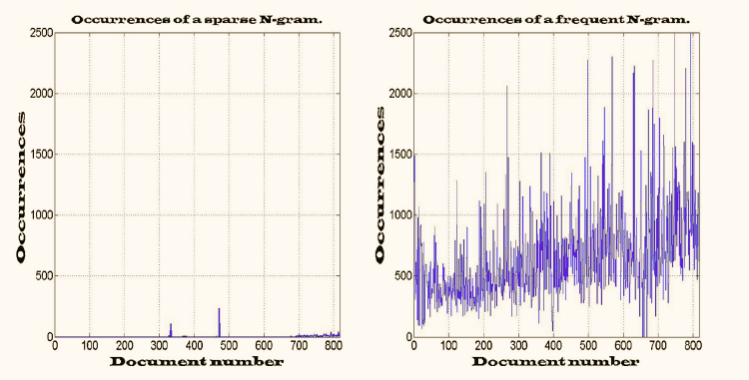
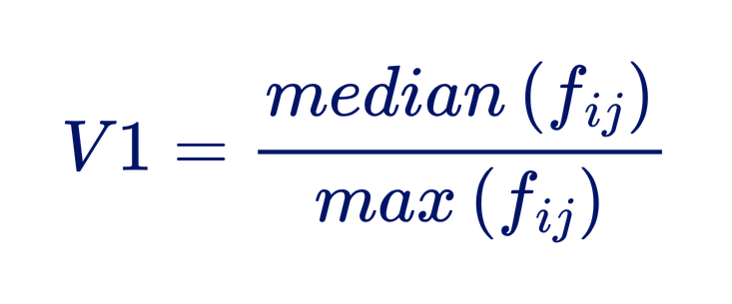
  Step 2: Feature Selection (Filtering the Noise)
The Problem:
  Vector Space Models create sparse, high-dimensional data. Most terms are rare and contribute only noise.
The Solution: The Normalized
Median (V1).
Method:
  We strictly select only N-grams that exceed a specific 'heaviness' threshold, filtering out transient chatter.

Slide 8
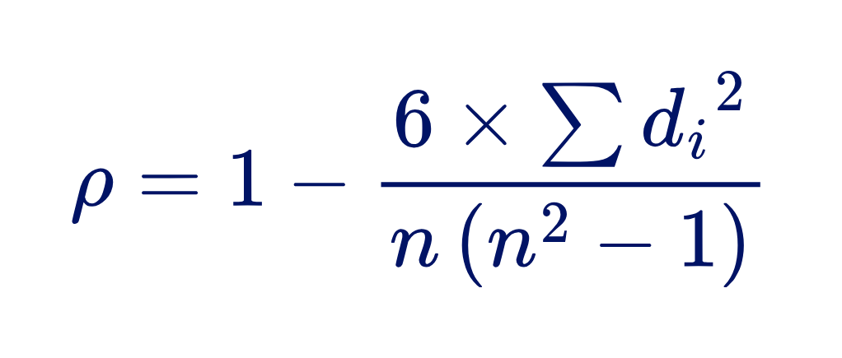
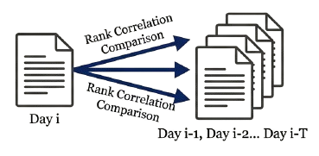
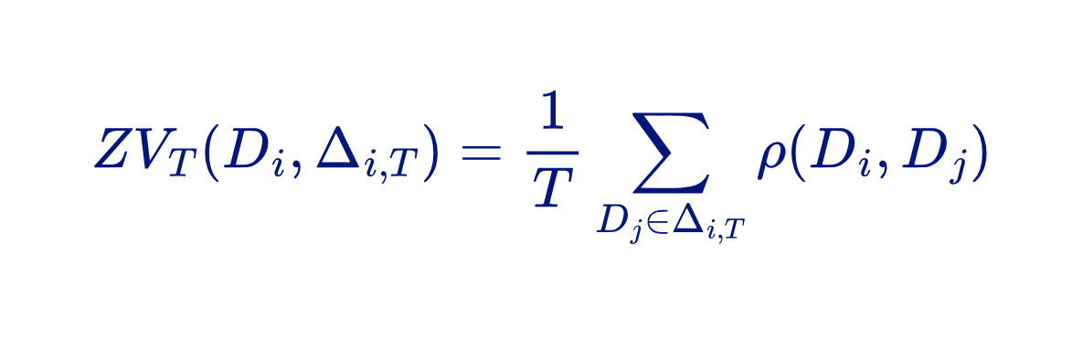
  Step 3: Measuring the 'Pulse' (Mean Rank Dependency)
  Discourse has "memory." Today's tweets are deeply influenced by yesterday's. We measure the stability of this relationship using Mean Rank Dependency (ZVT).
Interpretation:
  High Correlation: Stable discourse (Routine).
  Sharp Drop: A "Rupture" or Shock Event. The ranking of terms has fundamentally changed.

Slide 9
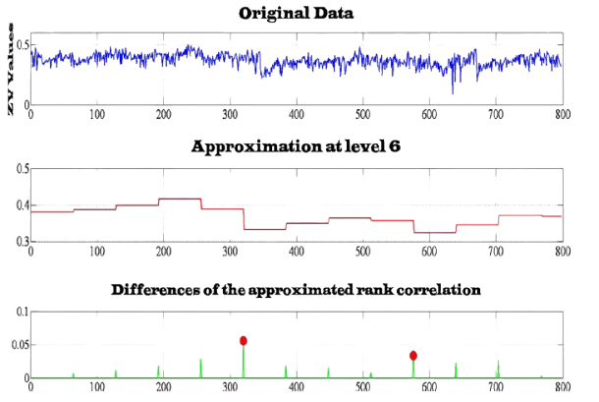
  Step 4: Detecting Change Points via Wavelets
  Raw correlation data is non-stationary and jittery. To find the exact moment a narrative shifts, we use the Haar Discrete Wavelet Transform.
  This acts as a 'step function' filter, smoothing the noise to reveal sharp edges (transitions).

Slide 10
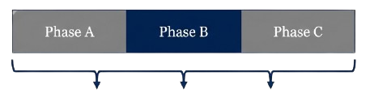
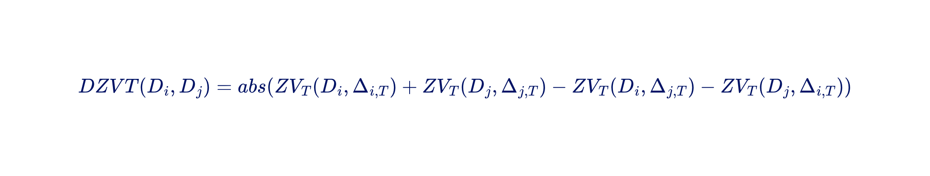
  Step 5: Clustering the 'Phases of War'
Objective: To partition the timeline into linguistically homogeneous groups (clusters).
Distance Metric (DZVT)
Algorithm: PAM (Partitioning Around Medoids). Selected for its robustness to outliers compared to K-Means.
DZVT measures 'Text Diversity.' If DZVT = 0, two days share the exact same linguistic style and belong to the same War Phase.

Slide 11
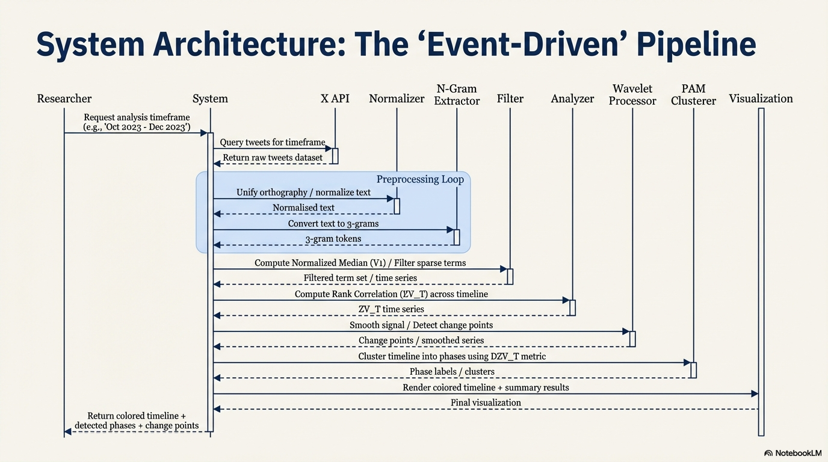
  System Architecture: The 'Event-Driven' Pipeline

Slide 12
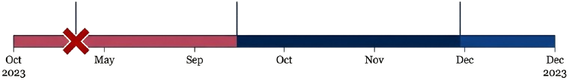
  Validation: Correlation with Geopolitical Reality
Oct 7
(Outbreak)
Oct 27
(Invasion)
Nov 24
(Ceasefire)
System detects sharp correlation drop (Rupture).
System marks a Phase Transition corresponding to ground maneuvers.
Clustering algorithm identifies a stable, homogeneous block distinct from combat phases.
Verdict: The linguistic shifts identified by the math align perfectly with known historical ground truth.

Slide 13

Comprehensive Testing Plan
Test Phase | Focus Area | Key Success Criteria
Unit Testing | Algorithm Accuracy | • Normalization maps variants correctly • Spearman Correlation • Distance Metric starts at 0
Integration | Pipeline Integrity | • Features reduced to 1-10% (Noise removed) • Output timeline match input days
Robustness | Code Health | • API Resilience (Auto-retry on 429 errors) • Zero crashes on malformed data
Ground Truth | Historical Validity | • Oct 7: Detect sharp correlation drop • Oct 27: Detect invasion transition • Nov 24: Detect ceasefire cluster

Slide 14
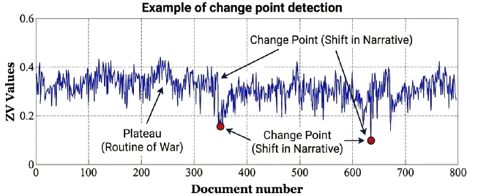
  Visualizing the Social State
The system successfully translates millions of chaotic tweets into a structured historical narrative, identifying periods of stability and rupture without human editorial intervention.

Slide 15
  Conclusion: A New Lens for Conflict Analysis
1
Upgraded Social Mirror
Moved from static press analysis to dynamic social mining,
capable of handling real-time data streams.
2
Linguistic Breakthrough
Overcame Arabic morphological barriers (prefixes/suffixes)
via n-gram root extraction and strict normalization.
3
Operational Utility
Provides defense analysts with an automated, quantitative
method to monitor the 'Social State' of a region in real-time.

